Slide 1
Traffic Sign Detection
Computer Vision – Project 1 – MIEIC – 13/14
Carlos Miguel Correia da Costa – 200903044 – Carlos.costa@fe.up.pt

Slide 2
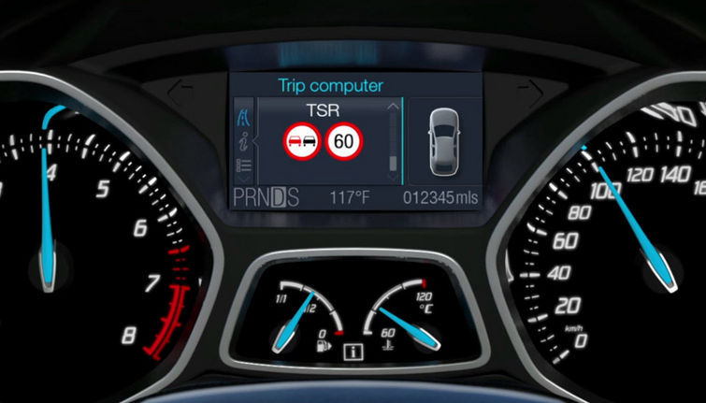
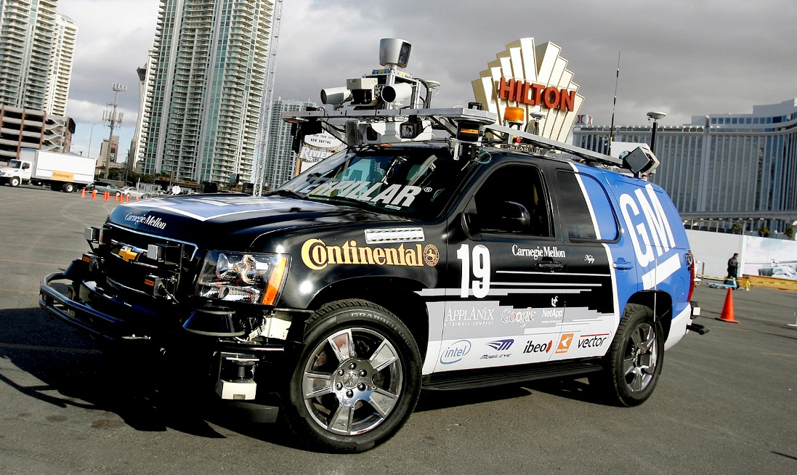
1. Applications
Fig. 1.1 - Driver assistance systems
Fig 1.2 - Autonomous vehicles

Slide 3
2. Implementation main algorithms
Scene acquisition (image, video, camera)
Image preprocessing
Signal color segmentation
Text color segmentation
Traffic sign recognition

Slide 4
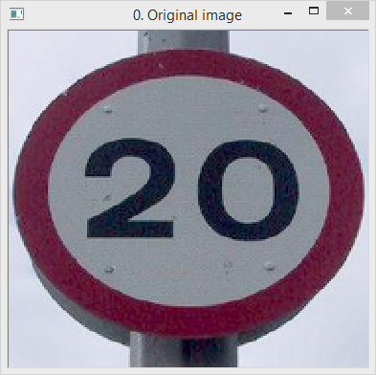

2.1. Image preprocessing
Bilateral filtering
Fig. 2.1a – Effect of the bilateral filter in removing noise

Slide 5
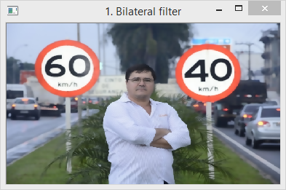
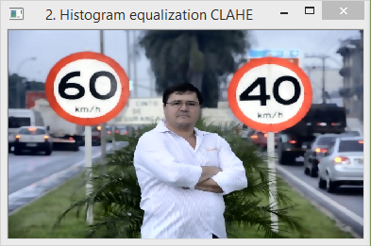
2.1. Image preprocessing
Contrast limited adaptive histogram equalization (CLAHE)
Fig. 2.1b – Effect of the CLAHE in increasing contrast

Slide 6
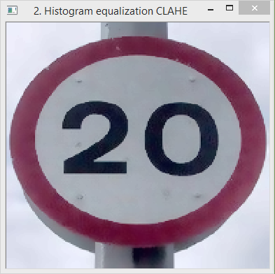
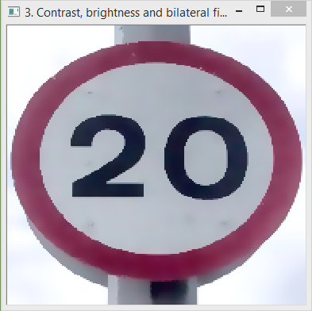
2.1. Image preprocessing
Contrast and brightness correction
Fig. 2.1c – Correction of contrast and removal of noise

Slide 7
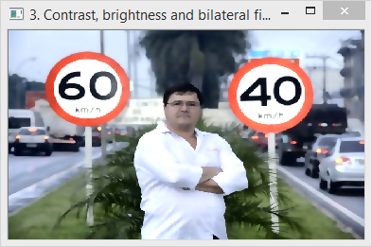
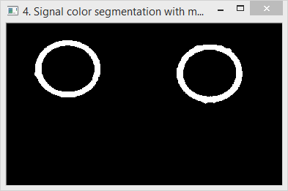
2.2. Signal color segmentation
Signal segmentation in HSV color space using the red borders
Usage of opening morphological operation to remove small blobs
Fig. 2.2a – Identification of possible traffic sign positions using color segmentation

Slide 8
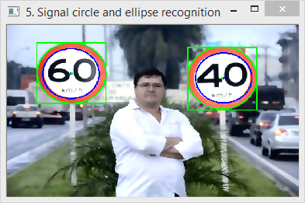
2.2. Signal color segmentation
Identification of signals circles using HoughCircles transform
Detection of signals borders with OpenCV fitEllipse
Fig. 2.2b – Usage of HoughCircles transform and ellipse extraction to segment the signals from the image

Slide 9
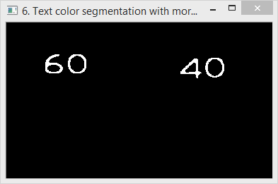


2.3. Text color segmentation
Extraction of each signal from the image, removing the background
Segment text only inside signs ellipsis
Usage of erosion operation to thin the text and improve recognition
Fig. 2.3b – Application of the erosion operator
Fig. 2.3a – Text extraction using color segmentation

Slide 10
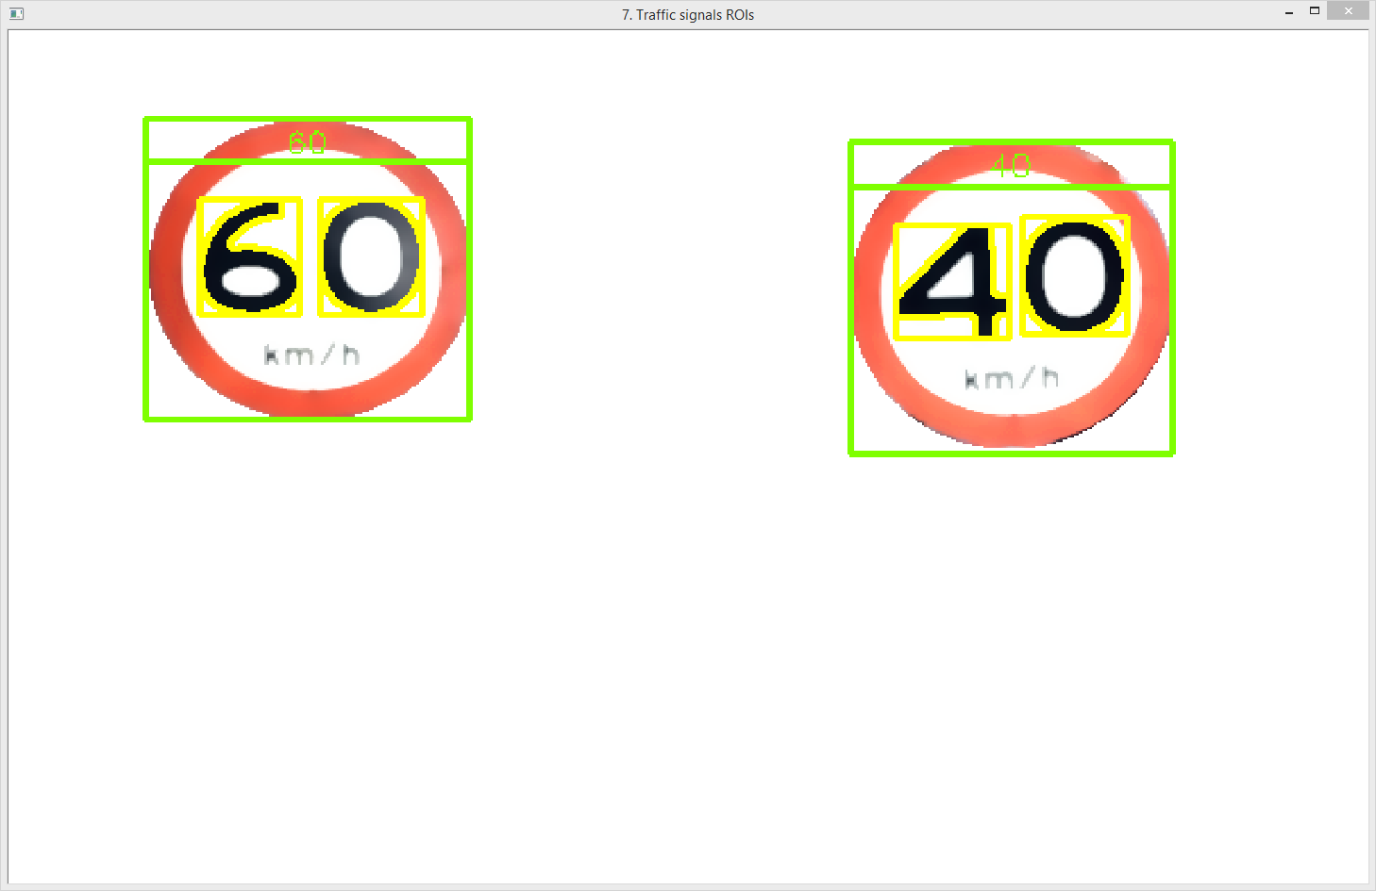
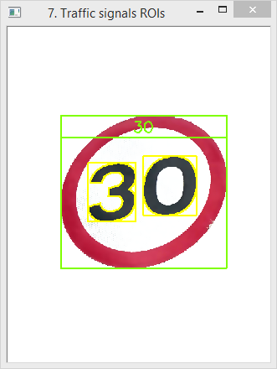
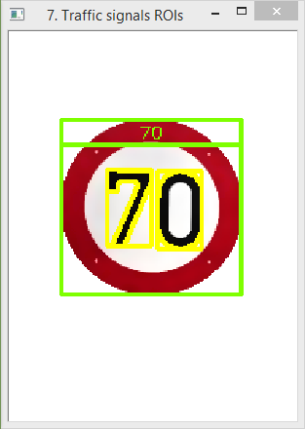
2.4. Traffic sign recognition
Application of template matching or feature detection to identify the numbers inside the traffic signs ellipsis
Fig. 2.4a – Number recognition using GoodFeaturesToTrackDetector, SiftDescriptorExtractor and FlannBasedMatcher

Slide 11
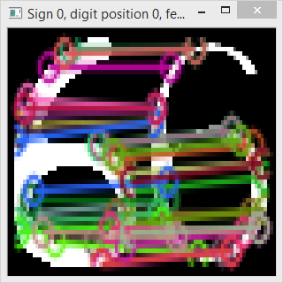
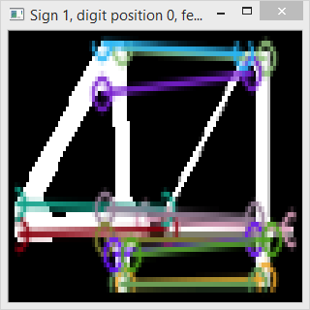
2.4. Traffic sign recognition
Feature detection results for signals with good segmentation and positioning
Fig. 2.4b – Good matches between feature points

Slide 12
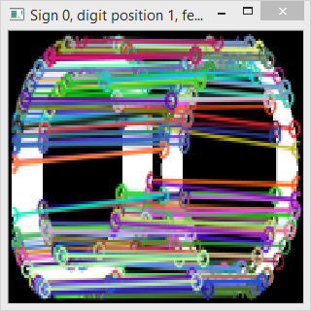
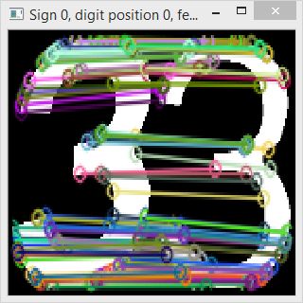
2.4. Traffic sign recognition
Feature detection results for signals with good segmentation and some perspective distortion
Fig. 2.4c – Good matches between feature points

Slide 13
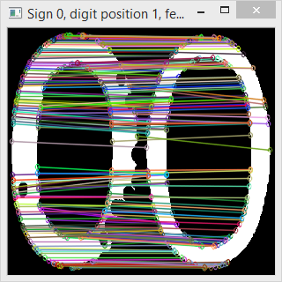
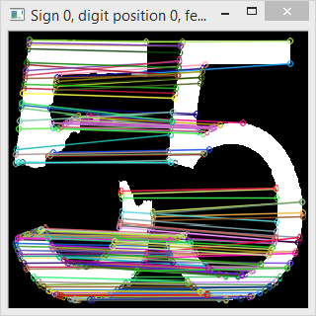
2.4. Traffic sign recognition
Feature detection results for signals with suboptimal segmentation (on purpose), and how the feature points adapted
Fig. 2.4d – Good matches between feature points

Slide 14
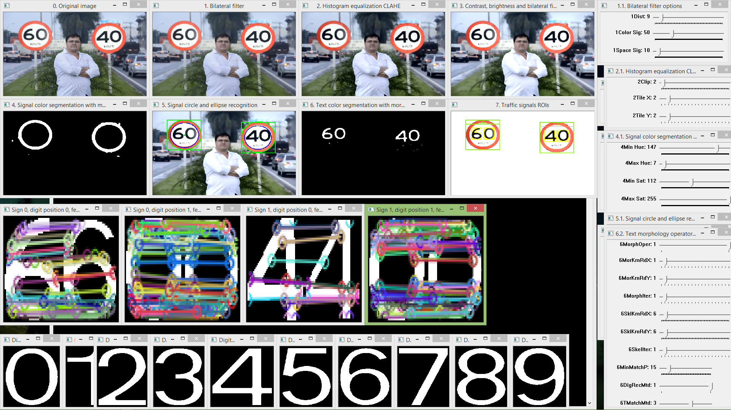
3.1. Parameterization
The HighGUI interface for main algorithms parameterization
Fig. 3a – HighGUI parameterization interface allows the customization of the algorithms parameters to obtain better results

Slide 15
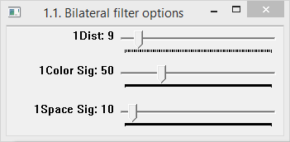
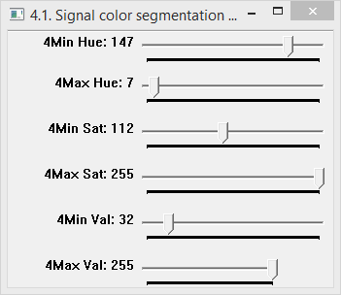
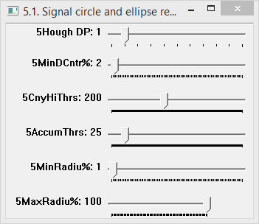
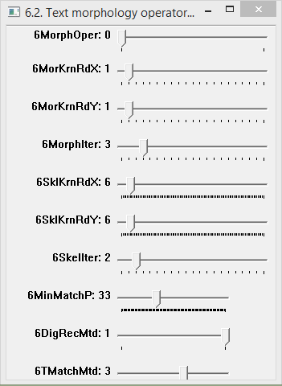
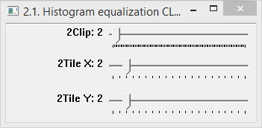
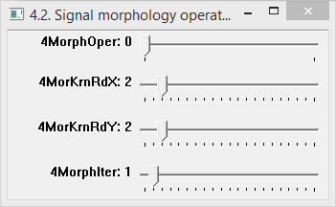
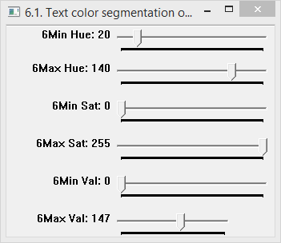
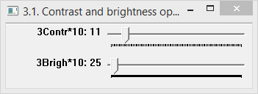
3.2. Parameterization
Default parameterization used
Fig. 3b – Parameterization to recognize normal speed limit signs

Slide 16
Questions?

